Slide 1

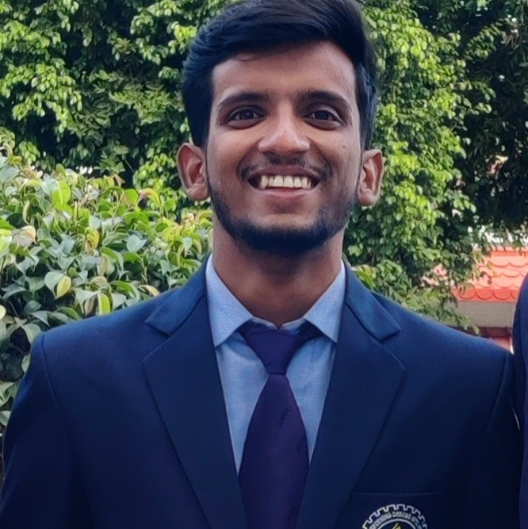
VIPUL
DevOps Engineer| Analyst | Software Engineer
Bachelors of Technology in Computer Science from Graphic Era Deemed To Be University , Dehradun– 2019-2023
Certification in GSDC - 2023
Vipul.a.vipul@capgemini.com
7668818230
Bangalore
Hindi, English
Enthusiastic and eager-to-learn DevOps enthusiast with a passion for building efficient systems to support software development. Recently graduated with a degree in Computer Science, eager to apply theoretical knowledge to real-world scenarios. Proficient in basic concepts of DevOps, including version control, continuous integration, and deployment automation. Familiarity with cloud computing platforms like AWS or Azure, and eager to learn more about containers like Docker and orchestration tools like Kubernetes. Strong team player with excellent communication skills, ready to collaborate and contribute to achieving project goals.
A Highly motivated and dedicated fresher, trained in DevOps , Working as a software Engineer in Capgemini.
2023 - Present: Capgemini
Languages | C , C++ , Python
Key Areas | DevOps , Web Development, Git
Database | SQL
Operating Systems | Windows, Linux

Slide 2
Assignments
Project Name - 1 | DevOps CI/CD pipeline for JAVA-based application
Client | CG Internal Training
Role | Analyst| Software engineer
Roles performed | Key responsibilities: Analyze the server. Implemented Continuous Integration and Continuous Delivery pipeline using Jenkins. Checked the code quality for the project using Sonarqube. Then after that to store the artifacts we used Sonatype Nexus. Then used Apache Tomcat to be able to see the frontend of the website.
Technology used in project | Git | Maven
 | GitHub | Sonarqube
 | Jenkins | Sonatype Nexus
 | Apache Tomcat
Description | Enhanced the efficiency of the CI/CD process for Java-based applications through Jenkins, with seamless integration with Maven , SonarQube and Sonatype Nexus .

